Slide 1
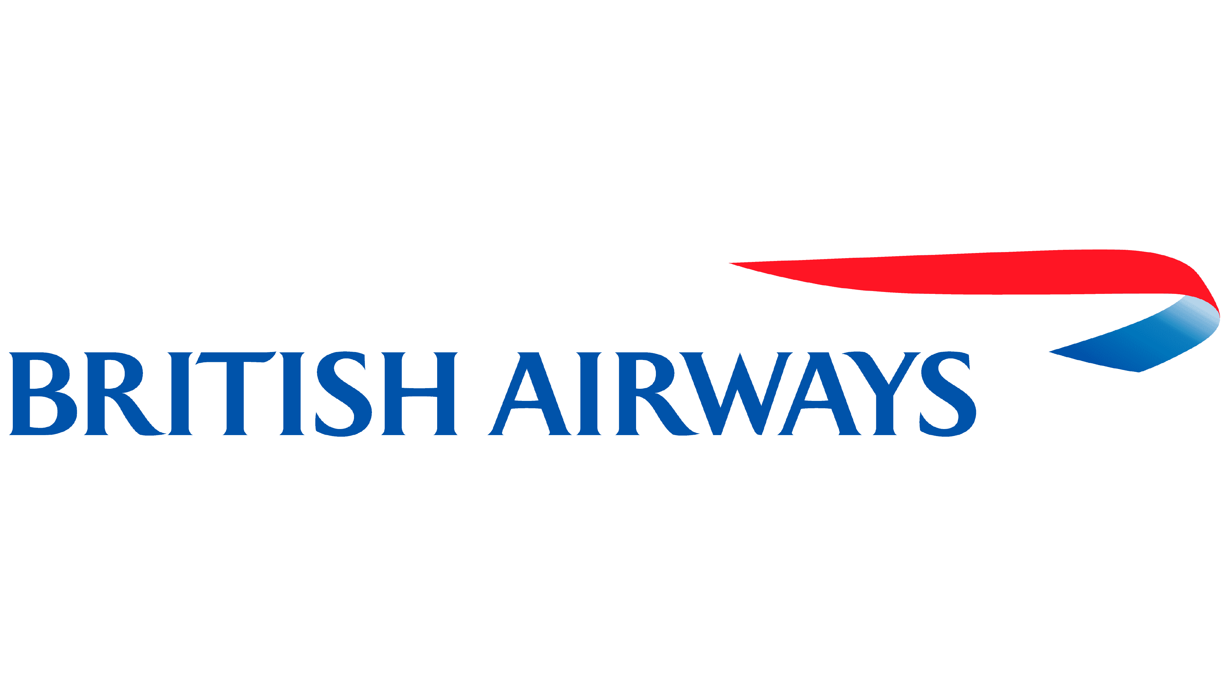
Analyzing Customer Review Data
By Ahmad Ari Aldino

Slide 2
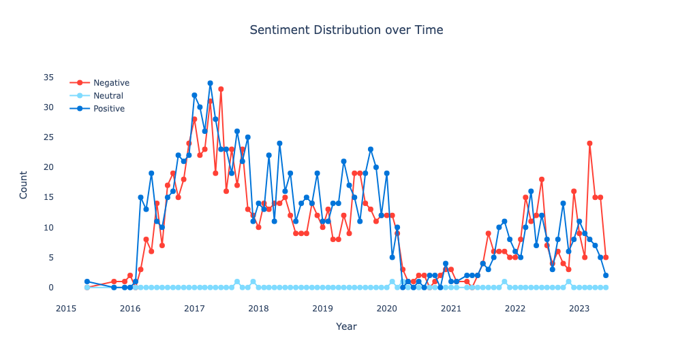
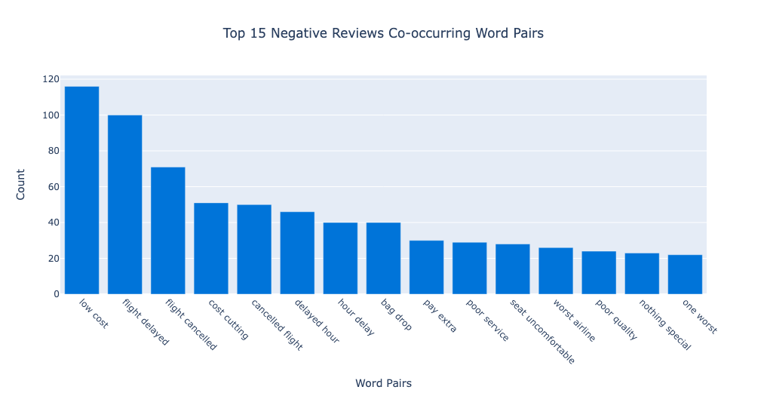
46.9%
Negative Reviews
52.8%
Positive Reviews
0.293%
Neutral Reviews
Problems: British Airways is facing a range of issues, including frequent flight delays, cancellations, poor service quality, uncomfortable seating, and additional costs. As a result, customer dissatisfaction and disappointment are evident, with approximately 46.9% of reviews being negative. Additionally, in the year 2023, there has been an increase in negative reviews, indicating a concerning trend.
Recommendations: To address these challenges, British Airways should prioritize several key actions. Firstly, improving communication regarding flight changes is crucial to keep passengers informed. Implementing contingency plans to effectively handle delays and cancellations is vital. Enhancing customer service through training and feedback management will help improve the overall experience. Upgrading seating comfort and amenities is essential to increase passenger satisfaction. Ensuring transparent pricing, without hidden fees, is important for building trust. Striving for operational efficiency will minimize disruptions. Additionally, the airline should focus on providing personalized experiences, unique offerings, streamlined baggage processes, and effective quality control measures. By implementing these recommendations, the airline can enhance customer satisfaction and improve the flying experience.

